Slide 1
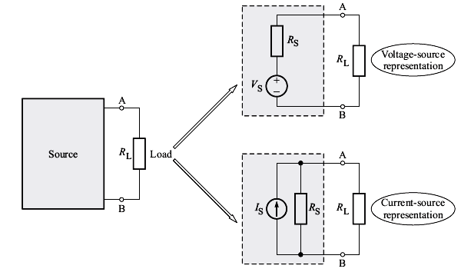

Slide 2
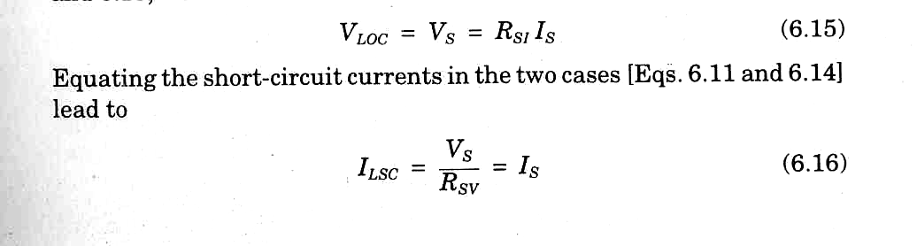

Equivalence between
Voltage Source and Current Source
Two sources would be equivalent if they produce identical values of V_{L} and I_{L}, when they are connected across the same load.

Slide 3
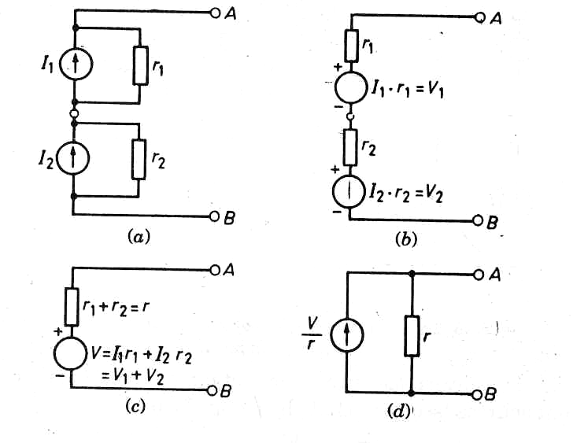
Practical Current Sources
Connected in Series

Slide 4
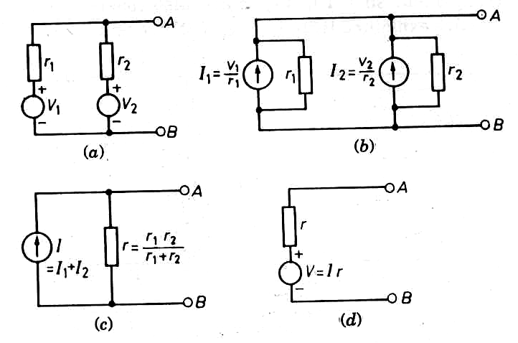
Practical Voltage Sources
Connected in Parallel

Slide 5
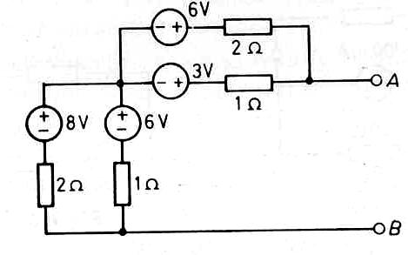
Example 1 : Reduce the network shown in figure to its simplest possible form by using source transformation.

Slide 6
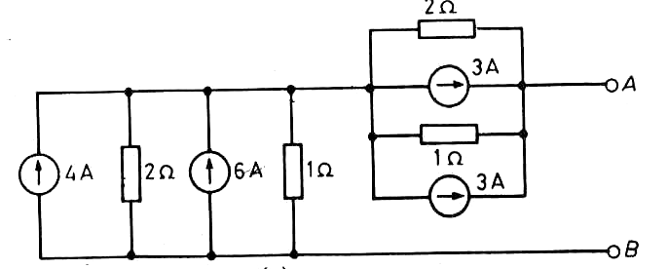
Solution

Slide 7

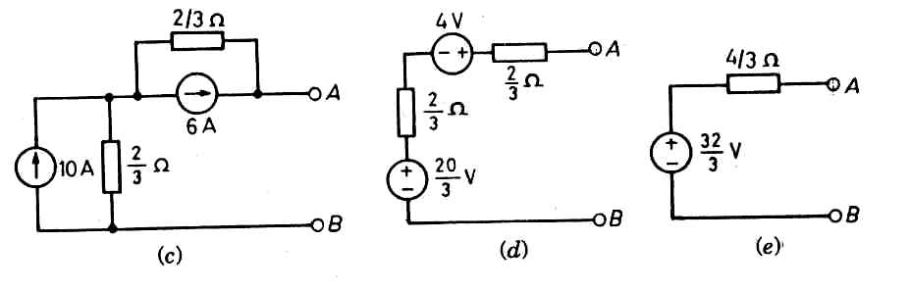

Slide 8
Example 2
In the given figure,
(a) if R_{L} = 80 Ω, find current i_{L.}.
(b) Transform the practical current source into a practical voltage source and find i_{L} if R_{L} = 80 Ω again.
(c) Find the power drawn from the ideal source in each case.

Slide 9
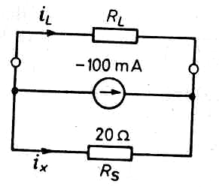

Slide 10
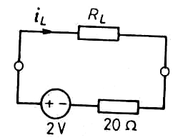
Solution
Ans. : (a) 20 mA, (b) 20 mA,
(c) 160 mW, 40 mW.

Slide 11
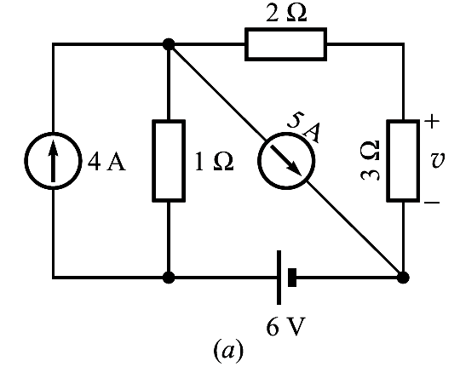
Example 3
Take the benchmark example of the circuit given in figure. Using source transformation, determine the voltage v across 3-Ω resistor.

Slide 12
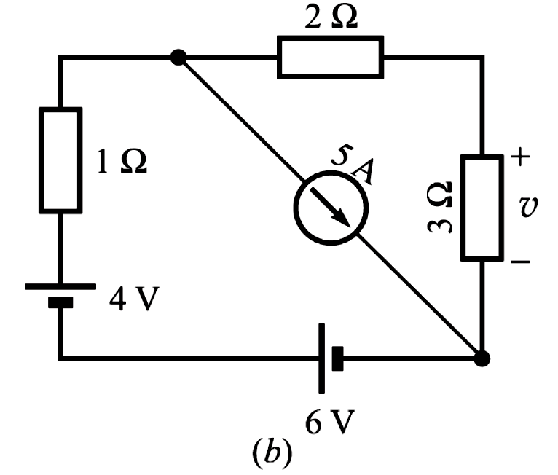
Solution :
Transforming the 4-A current source into a voltage source,

Slide 13
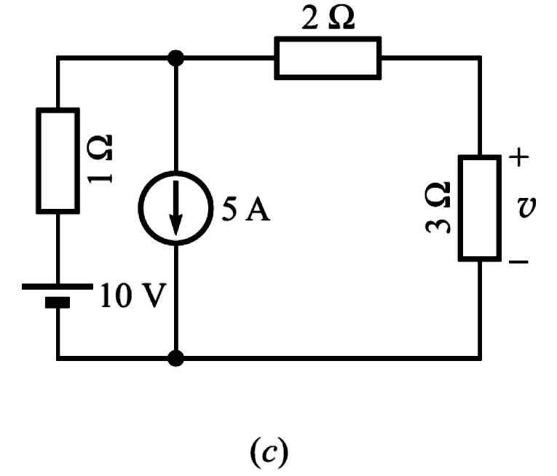
Combining the two voltage sources,

Slide 14
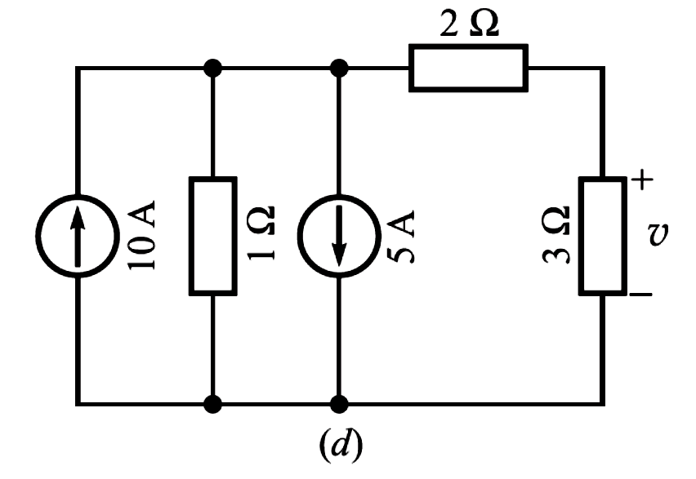
Again transforming the voltage source into current source,

Slide 15
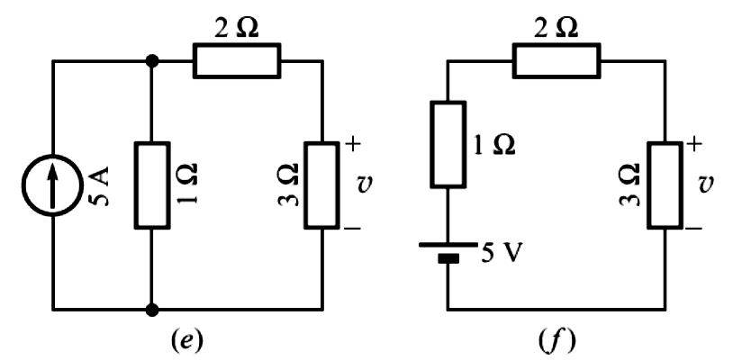
Combining the two current sources we get Fig. (e). Transforming this current source into voltage source (Fig. f )

Slide 16
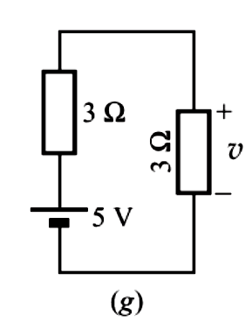
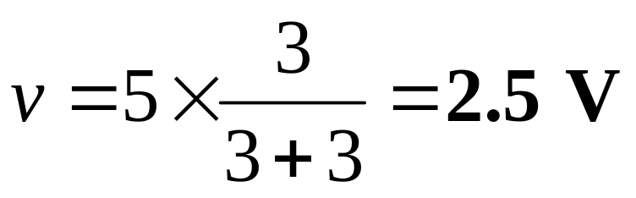
Combining the two resistances, we get Fig. (g).
Finally, using voltage divider, we get

Slide 17
Dependent Sources
The value of dependent sources depends on some other current or voltage.
These are also known as controlled sources.
Represented by a diamond shape.
Applications in electronics, in amplifiers, having a pair of input terminals and a pair of output terminals.
There are four types of Dependent Sources.

Slide 18
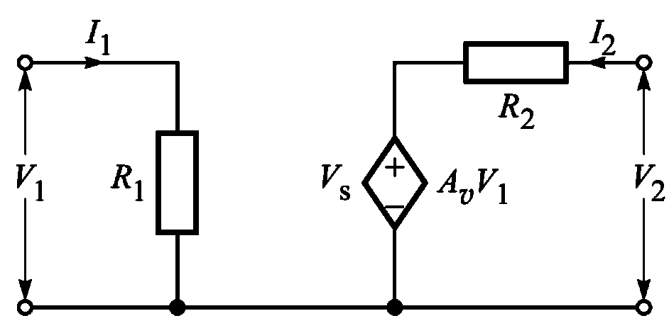
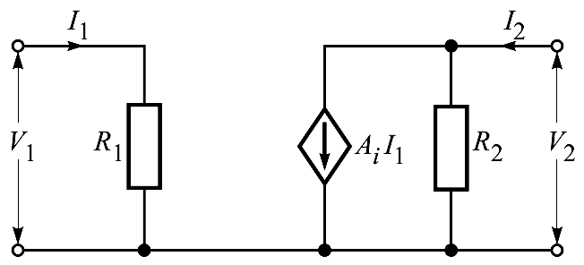
A_{v} is called
voltage ratio
(having no units).
(a) Voltage controlled voltage source (VCVS).
A_{i} is called
current ratio
(having no units).
(b) Current controlled current source (CCCS).

Slide 19
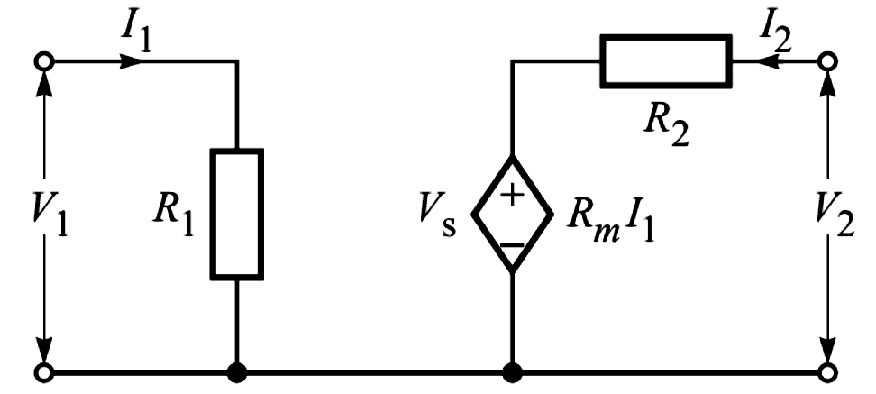
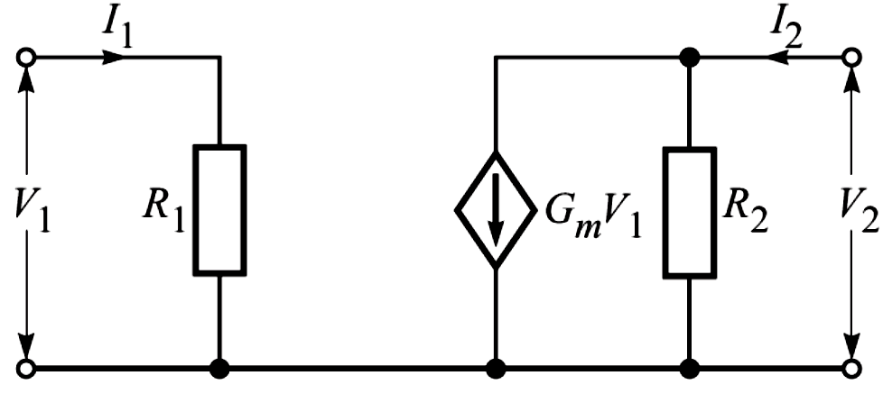
R_{m} is called
mutual resistance
(with units of Ω).
(c) Current controlled voltage source (CCVS).
Gm is called
mutual conductance
(with units of S).
(d) Voltage controlled current source (VCCS).

Slide 20
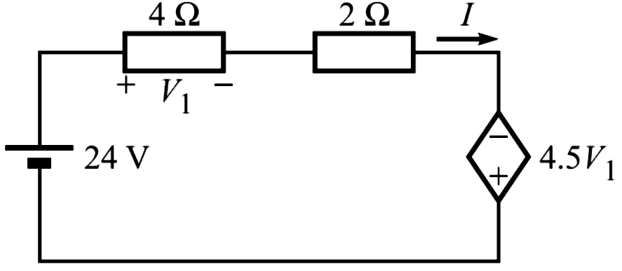
Example 4
For the given circuit, determine
(a) the value of current I,
(b) the power absorbed by the dependent source, and
(c) the resistance “seen” by the independent voltage source.

Slide 21
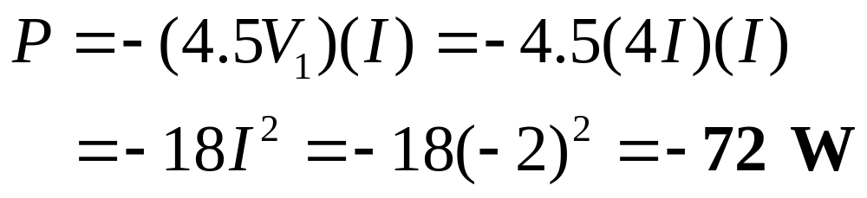
Solution :
(a) Applying Ohm’s law to the 4-Ω resistor, gives V₁ = 4I . Therefore, the value of dependent voltage source is 4.5V₁ = 4.5(4I) = 18I. By applying KVL,
What is the meaning of negative sign ?
(b) For the dependent source, the power absorbed is

Slide 22
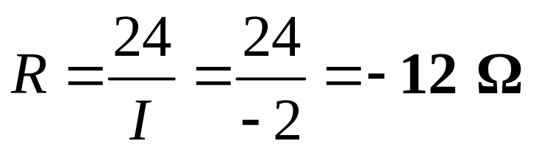
(c) The resistance “seen” by the independent voltage source,
What is the meaning of negative sign ?

Slide 23
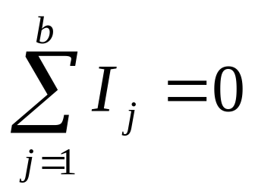
Kirchhoff’s Laws
(1) KCL : Algebraic sum of currents meeting at a junction of conductors in a circuit is zero.
It is simply a restatement of the principle of conservation of charge.

Slide 24
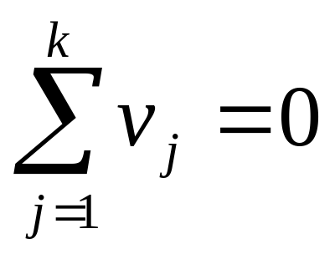
(2) KVL :The algebraic sum of voltages around a closed circuit or a loop is zero.
It is simply a restatement of the principle of conservation of energy.

Slide 25
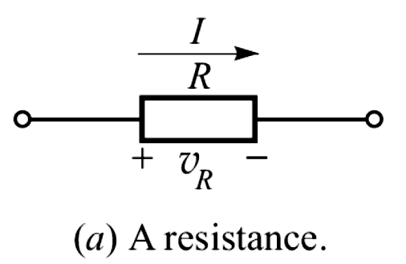
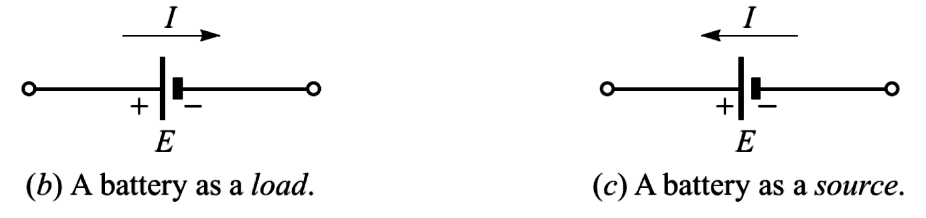
Polarity of Voltages
Note that polarity of the voltage (emf) across a battery does not depend upon the assumed direction of current.

Slide 26
Applying KVL
Select a closed loop.
Mark the voltage polarity (+ and -) across each element in the closed loop.
Go round the selected loop, and add up all the voltages with + or – signs.
Any one of the following two rules can be followed :

Slide 27
(i) Rule 1 : While traveling, if you meet a voltage rise, write the voltage with positive sign ; if you meet a voltage drop, write the voltage with negative sign.
(ii) Rule 2 : While traveling, write the voltage with positive sign if + is encountered first; write the voltage with negative sign if – is encountered first.
We shall be following Rule 1, as it has a strong analogy with the physical height (altitude) of a place.

Slide 28
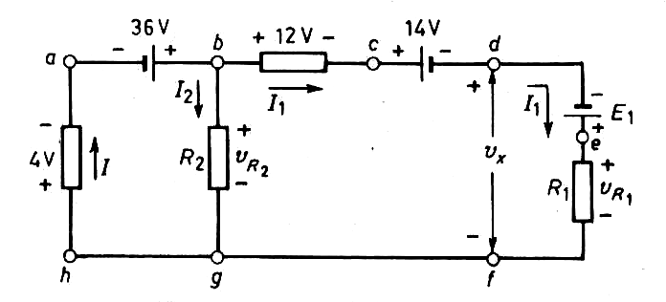
Example 5 : Use KVL to find v_{R2} and v_{x}.

Slide 29
For finding v_{R2}, we write KVL eqn. going around loop abgha clockwise :
If you choose to go around the loop anticlockwise, you get
Giving the same result.

Slide 30
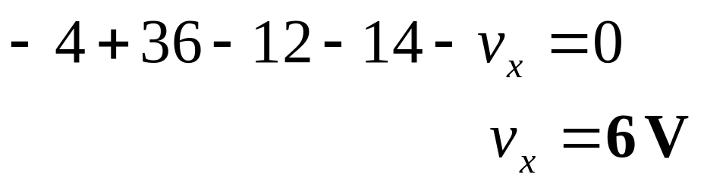
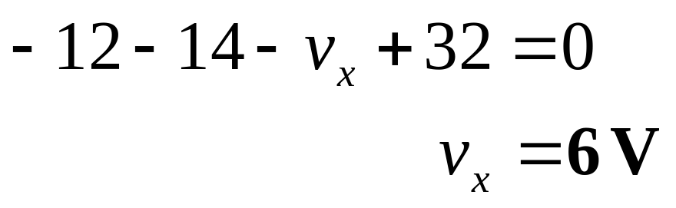
There are two ways to determine v_{x}
1) We can consider this voltage as the voltage across the gap from d to f. Writing KVL (habcdfgh) :
2) Knowing v_{R2} , apply a short-cut (bcdfgb) :

Slide 31
Important Note about KVL
The assumed direction of current through a resistor and the polarity of voltage across it are always in conformity.
The end into which the current enters is marked positive.
Passive-element sign convention.

Slide 32
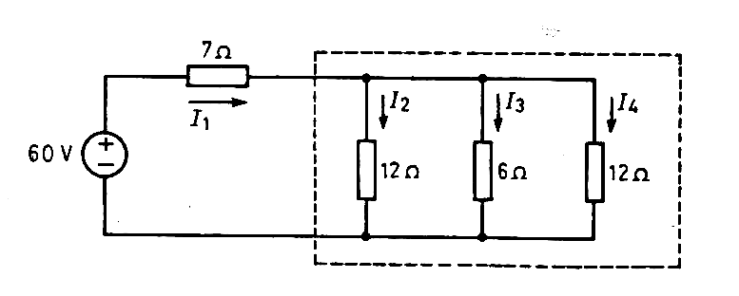
Example 6 : Find the current supplied by the 60-V source in the network.

Slide 33
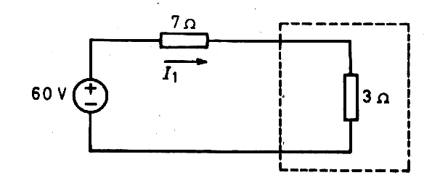

Solution :
We need not find the currents I₁, I₂ and I₃.
Instead, we reduce the network.

Slide 34
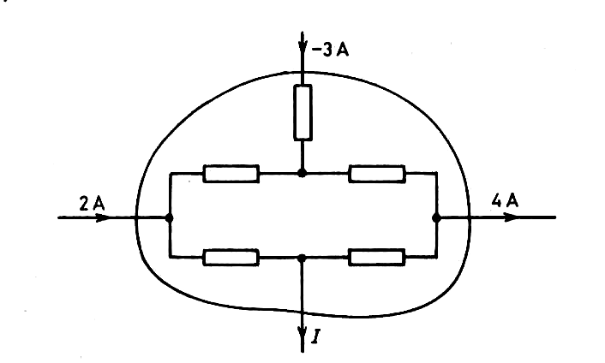
Example 7 : Determine the value of current I.
2 – 3 – I – 4 = 0 or I = -5 A

Slide 35
Review
Electric Circuit,
The Resistance Parameter,
The Capacitance Parameter,
The Inductance Parameter,
Energy Sources--Classification
Ideal Voltage Source.
Ideal Current Source.
Series and Parallel Combinations.
Practical Voltage Source.
Practical Current Source.
Source Transformation.
Dependent Sources.
Kirchhoff’s Laws.

